Slide 1
Zimbabwe (Harare) Weather Forecast

Slide 2
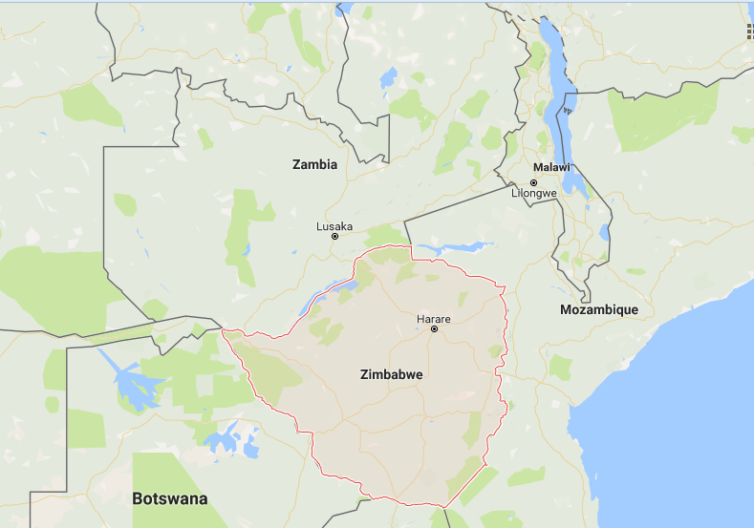

Slide 3
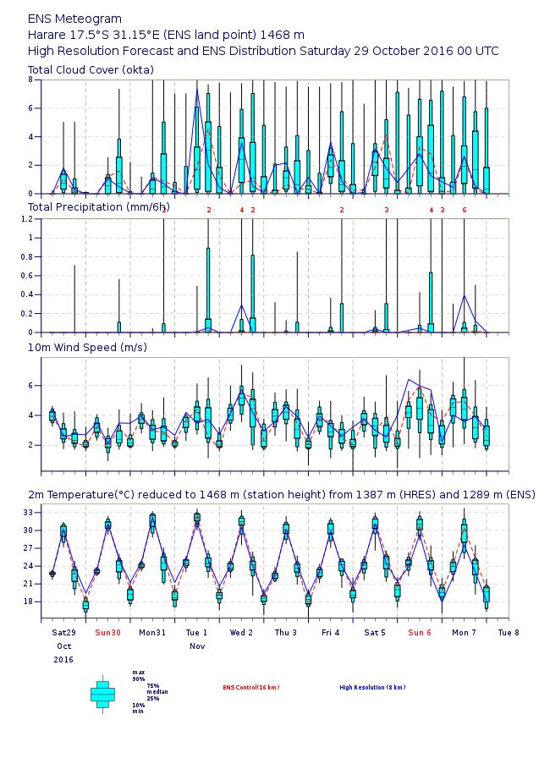

Slide 4
Harare Weather Forecast
 | SUNDAY | MONDAY | TUESDAY
CLOUDINESS | Sunny | Sunny | Partly cloudy to cloudy
RAINFALL | - | Slight showers in places | -
WIND | Light breeze | Light breeze | Gentle breeze
MAX TEMP. | 32 | 31 | 33
MIN TEMP. | 20 | 21 | 22

Slide 5
Malawi (Lilongwe) Weather Forecast

Slide 6
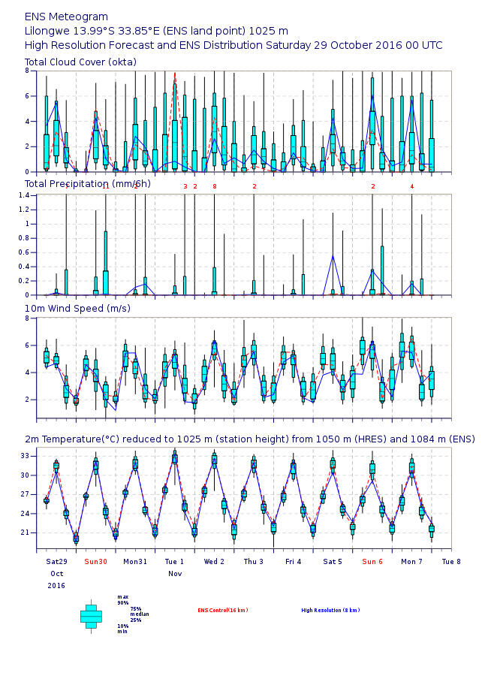

Slide 7
Lilongwe Weather Forecast
 | SUNDAY | MONDAY | TUESDAY
CLOUDINESS | Partly cloudy | Mainly Sunny | Sunny
RAINFALL | - | - | Slight showers in places
WIND | Gentle breeze | Gentle breeze | Gentle breeze
MAX TEMP. | 32 | 31 | 33
MIN TEMP. | 19 | 21 | 21

